Slide 1

COVID Data Analysis
By:
Ranjani Anjur Venkatraman
Cody Gardner
Sharon Colson
Notes:
Cody Gardner

Slide 2
Agenda
General Information
Exploratory Data
Visualizations/Data Trends
Linear Regression
Hypothesis Tests
Conclusion
Questions
Notes:
Cody Gardner

Slide 3
General Information
Background:
Analyzing the trends in COVID data for different countries in the world
Resources/APIs:
Historical API :
Using Historical API retrieved 30 days data of Cases, Deaths, and Recovered for multiple countries across world
Link : https://disease.sh/v3/covid-19/historical/
Vaccination API :
Using Vaccination API retrieved vaccination information for multiple countries across world
Link : https://disease.sh/v3/covid-19/vaccine/coverage/countries?lastdays=1
Daily data API :
Using Daily data API retrieved present day covid information
Link : https://disease.sh/v3/covid-19/countries/
Notes:
Sharon

Slide 4
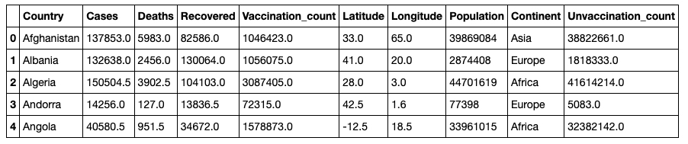
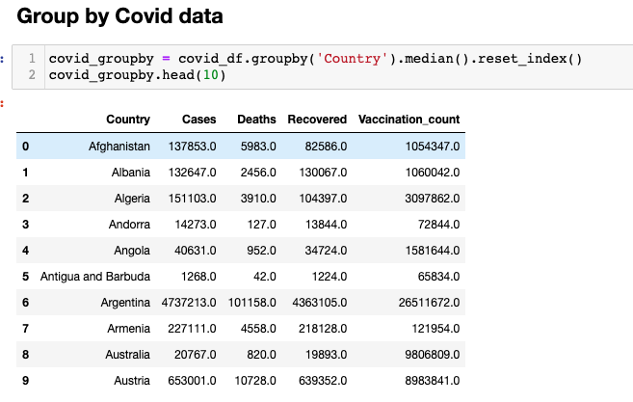
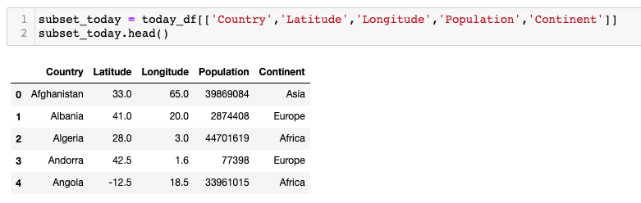
Main COVID Data Frame
Notes:
Sharon

Slide 5
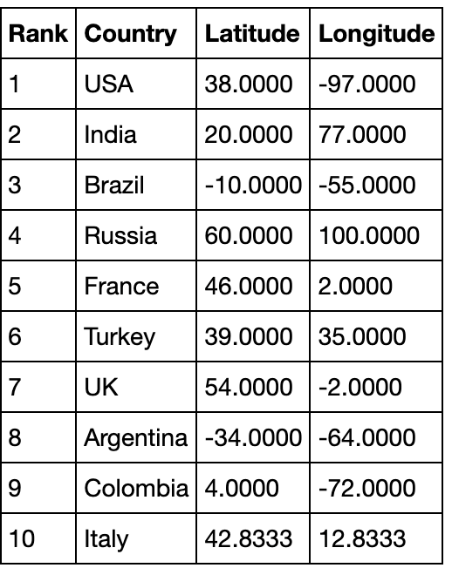
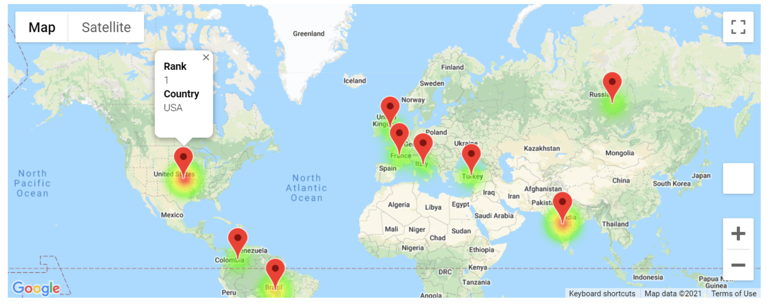
Top 10 Vaccinated Countries
Notes:
Ranjani

Slide 6
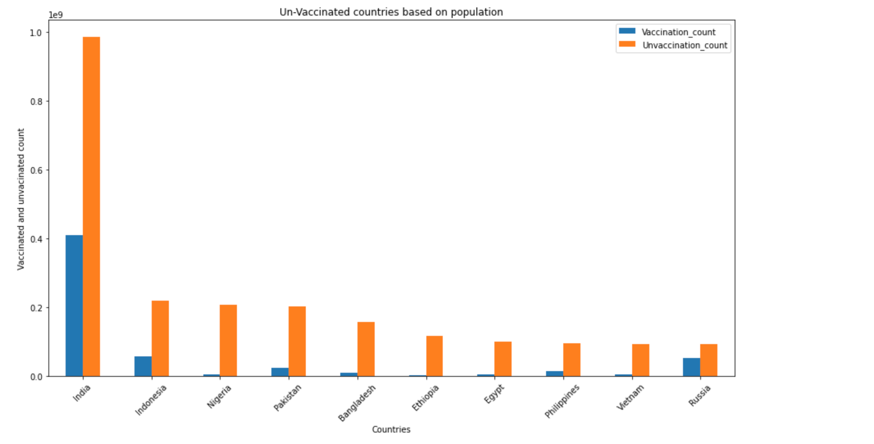
Top 10 Unvaccinated Countries
Notes:
Ranjani

Slide 7
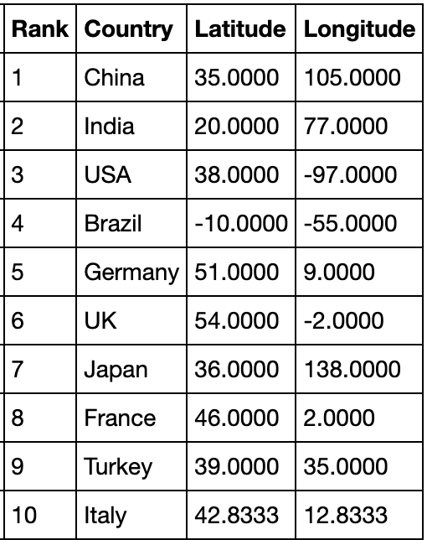
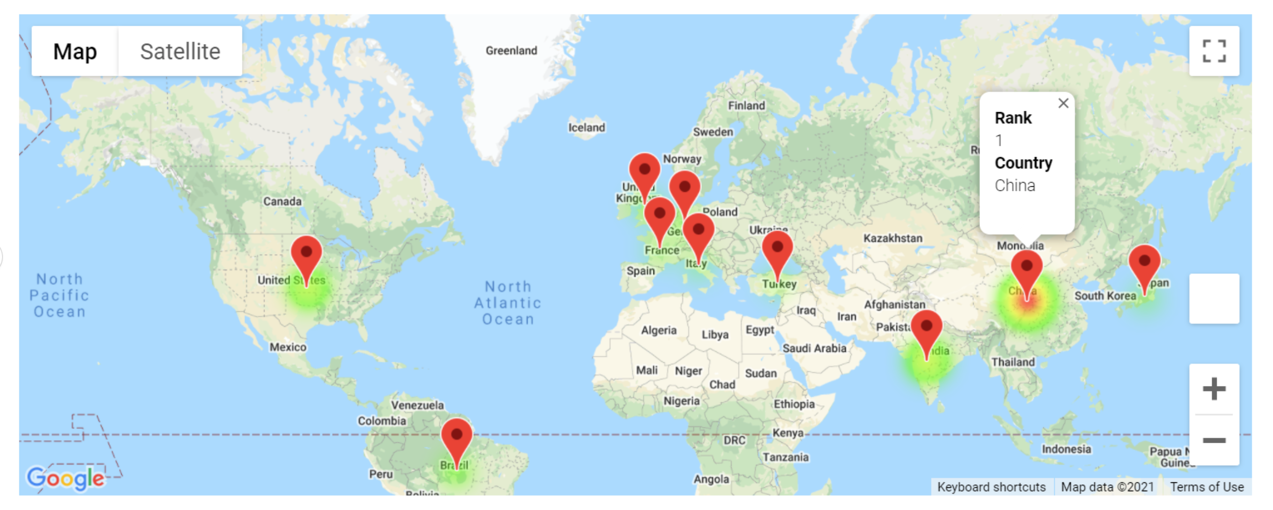
Top 10 Countries with Highest COVID Cases
Notes:
Cody

Slide 8
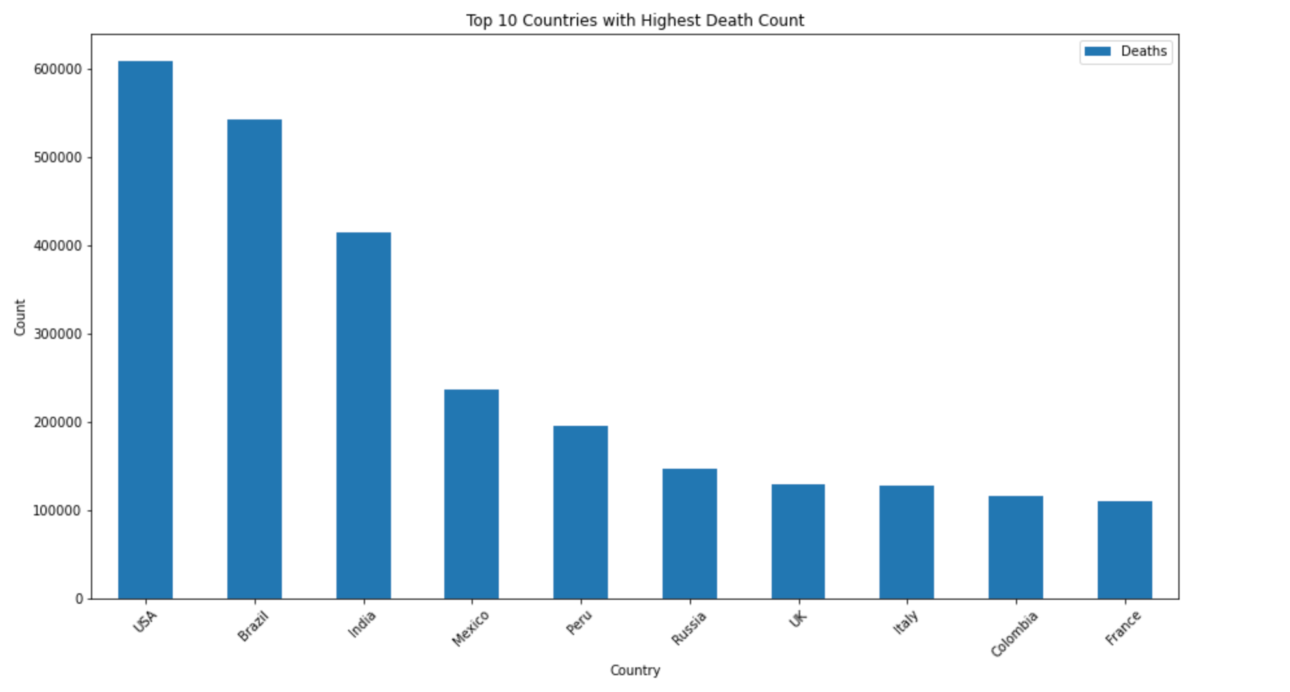
Top 10 Countries by Death Count
Notes:
Cody

Slide 9
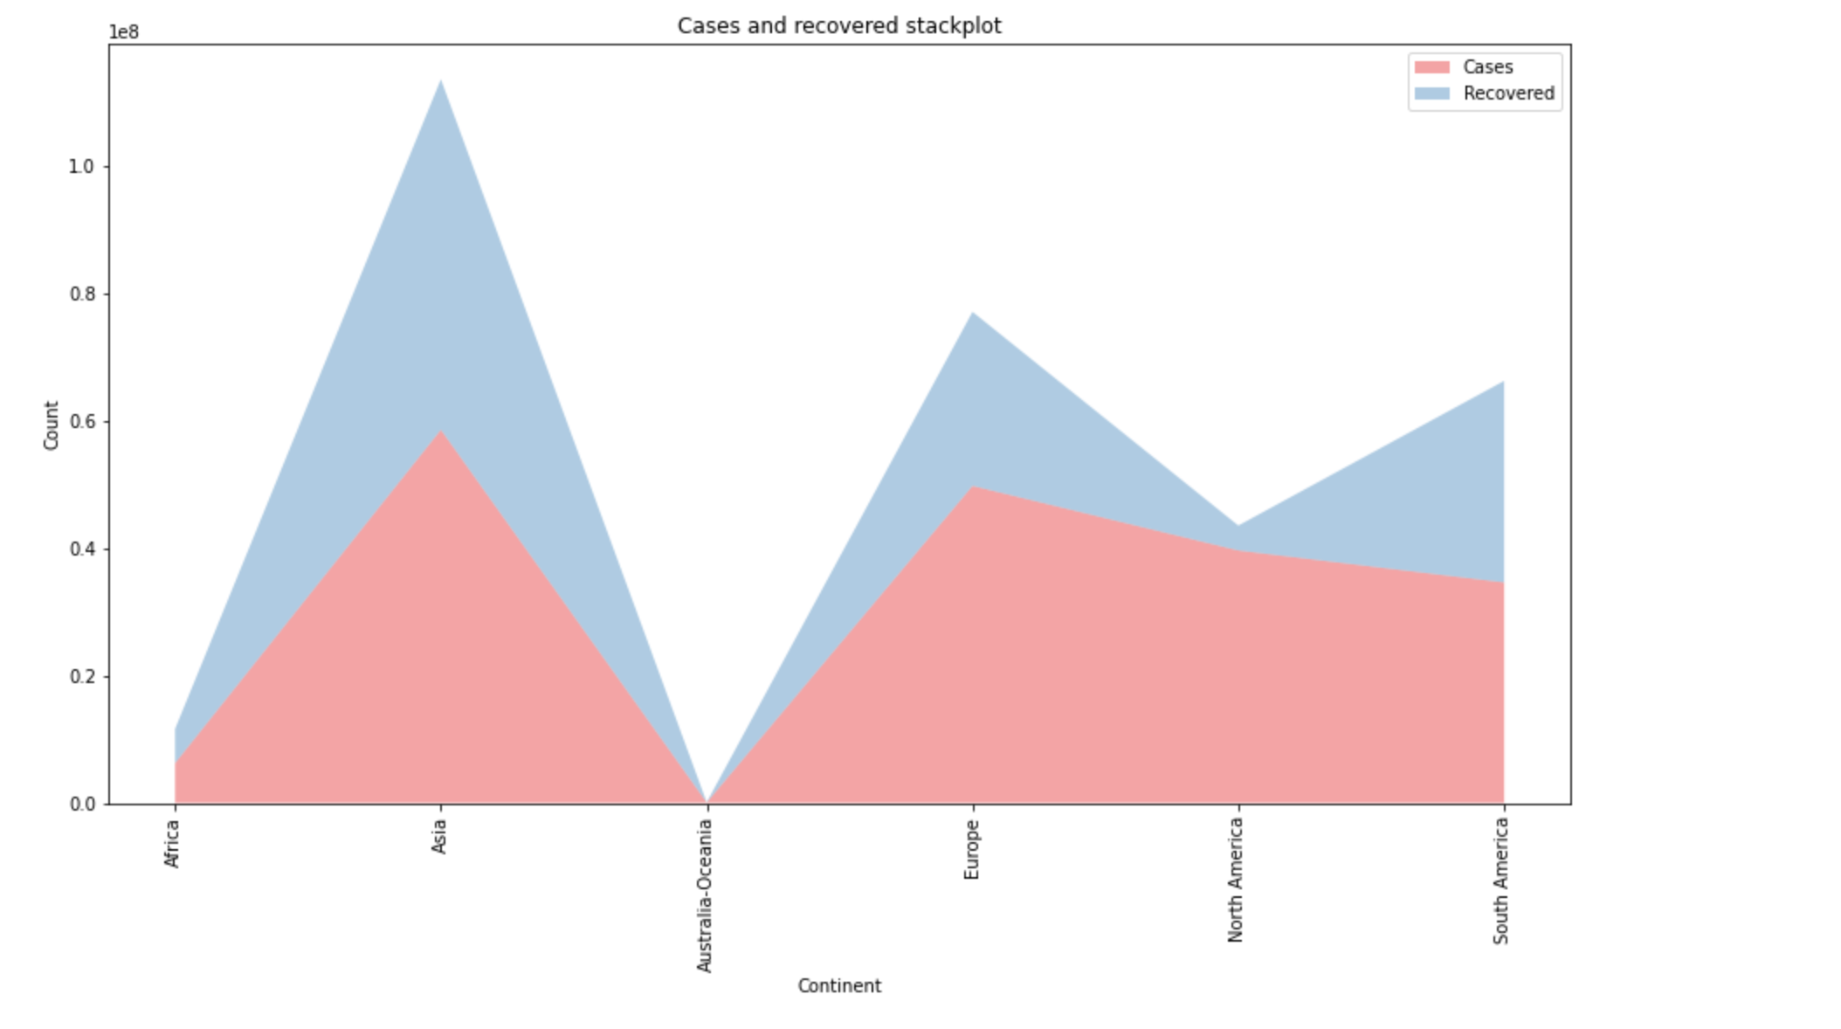
Cases and Recoveries
Notes:
Sharon

Slide 10
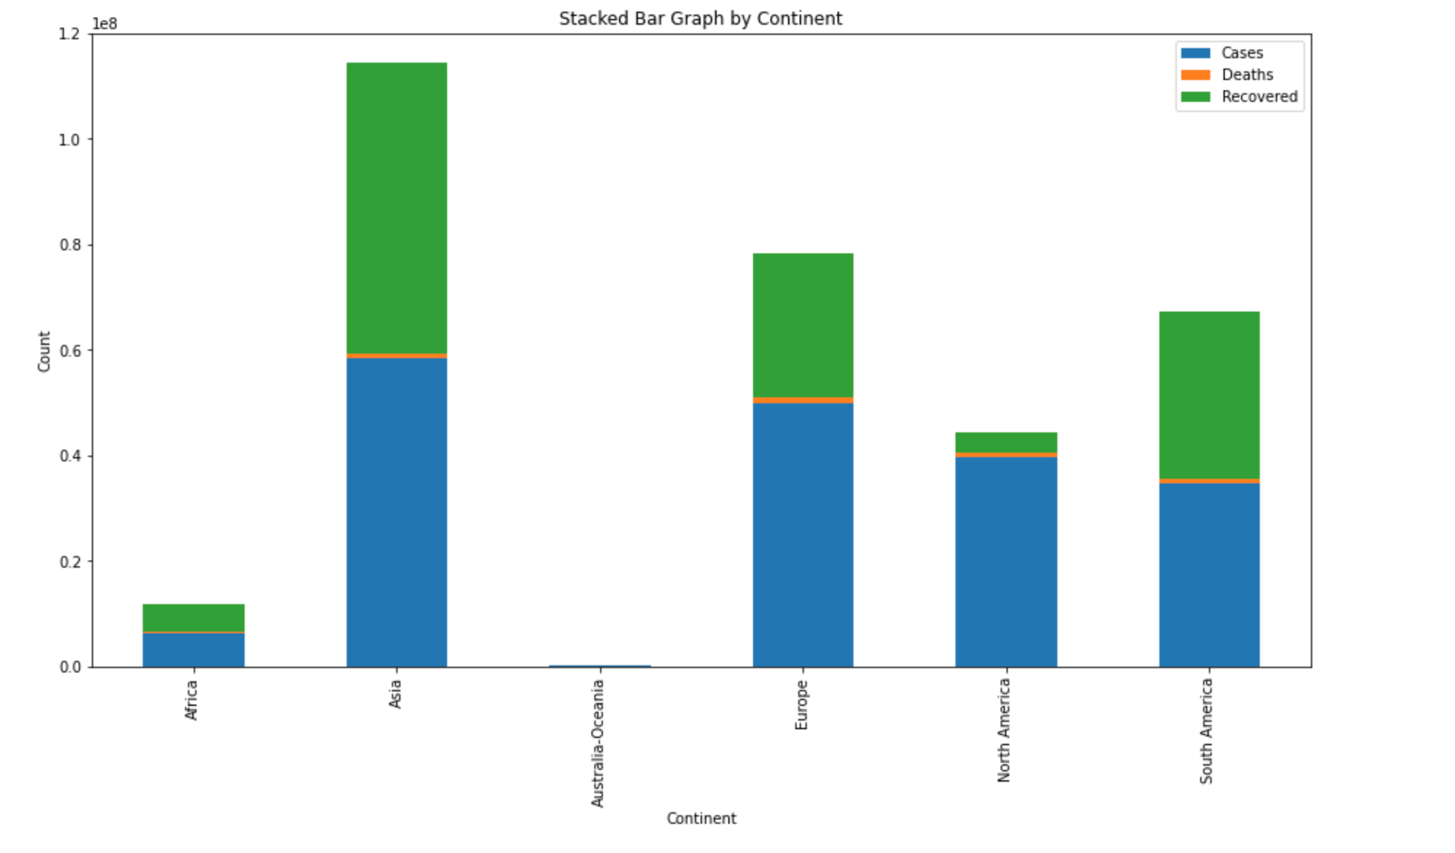
COVID Summary by Continent
Notes:
Sharon

Slide 11
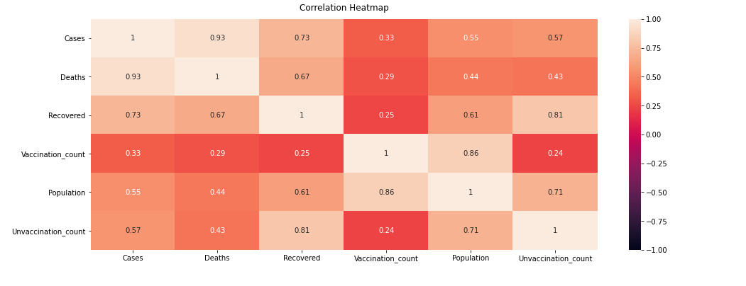
Correlation Matrix
Notes:
Cody

Slide 12
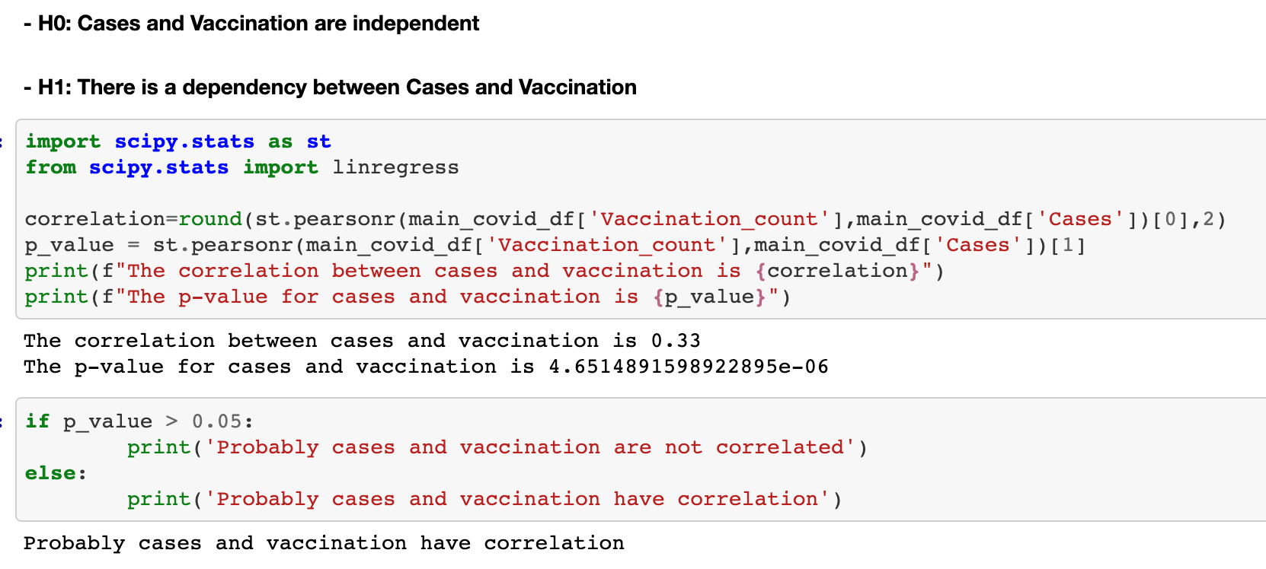
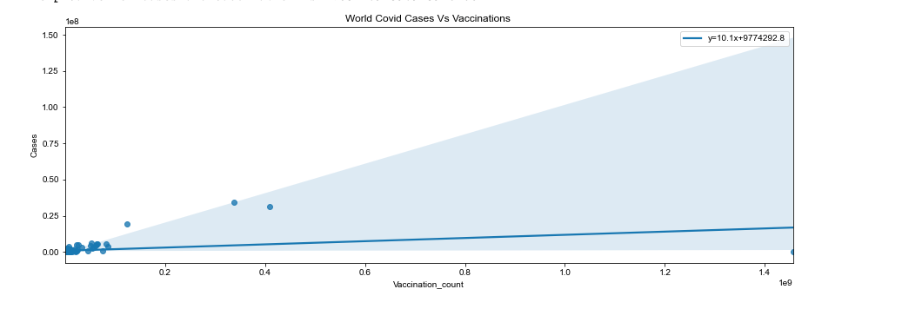
Pearson’s Correlation Coefficient
Hypothesis:
H0: Cases and Vaccination are independent
H1: There is a dependency between Cases and Vaccination
Inference:
Since p-value is less than 0.05 we can reject null hypothesis and accept the alternate hypothesis that there is a dependency between cases and vaccination
Notes:
Ranjani

Slide 13
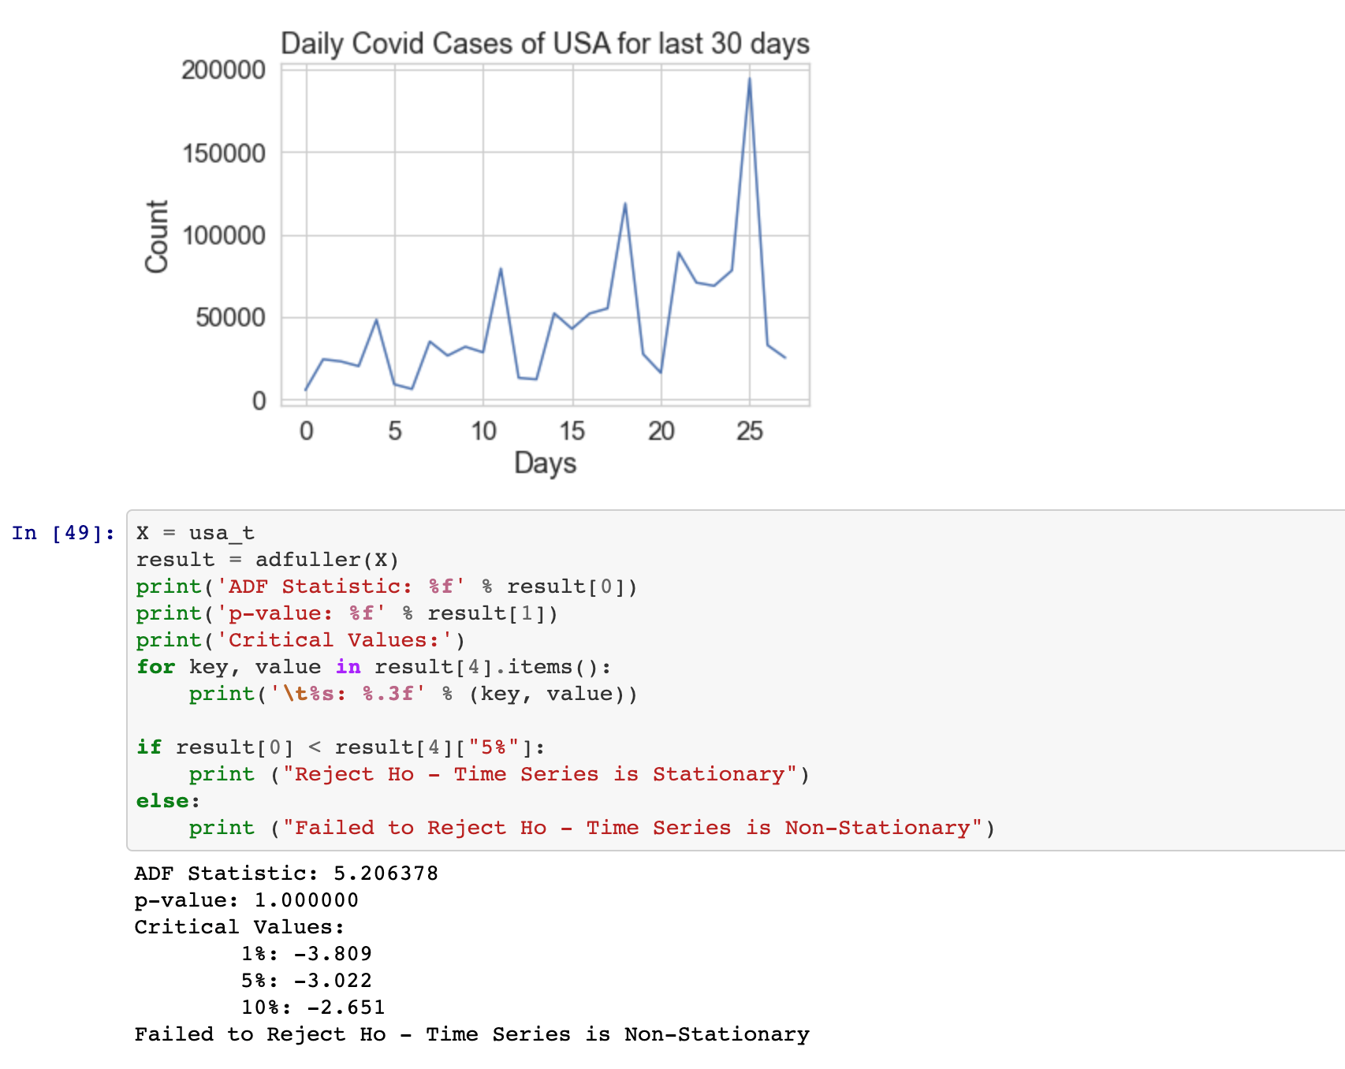
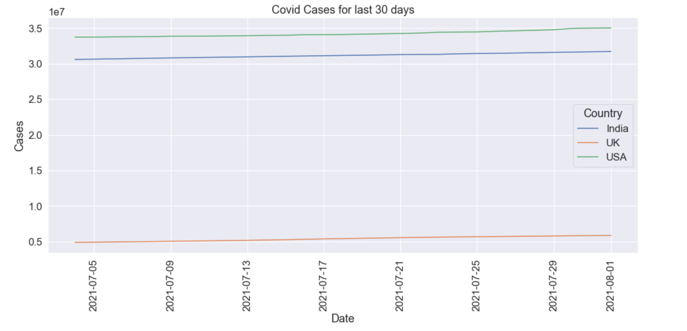
Augmented Dickey Fuller Test
Hypothesis:
H0: a unit root is present (series is non-stationary).
H1: a unit root is not present (series is stationary).
Inference:
As p-value is greater than 0.05 and ADF statistic > greater than critical value we fail to reject null hypothesis. So, the time series data is non-stationary
Notes:
Ranjani

Slide 14
Conclusion and Takeaways
Conclusion:
Based on the analysis, we are seeing an upward trend and seasonality in COVID cases
Takeaways:
The suggestion of this analysis to any business owner or manager would be to prepare an action plan for further restrictions due to rise in Covid-19 cases.
Further analysis based on a larger time frame (say 90 or 180 days) might give additional information
It could be that vaccination counts have not yet come to a number that would cause Covid-19 cases to fall or that the new Delta (or any subsequent) variant will cause Covid-19 cases to continue to rise despite increasing vaccination counts.
Notes:
Sharon

Slide 15

Thank you !!
Any questions??
Notes:
Everybody!!!!!!!!

